Slide 1
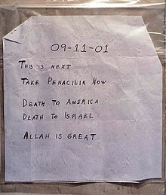
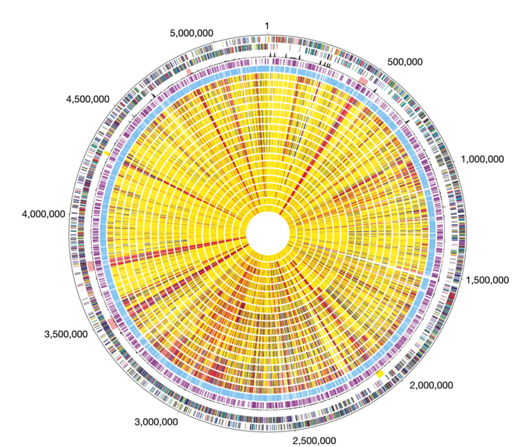

Amerithax From genome to culprit?
?
Professor Mark Pallen

Slide 2
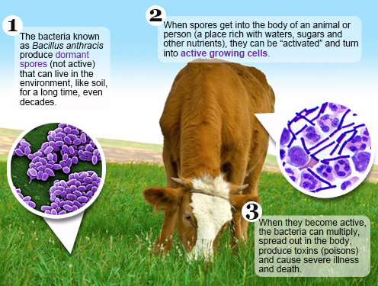
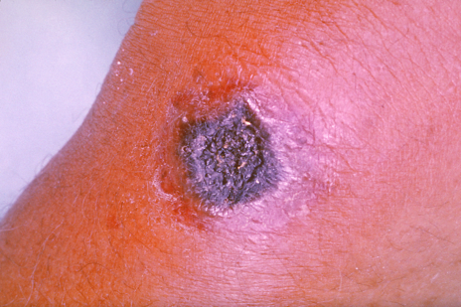
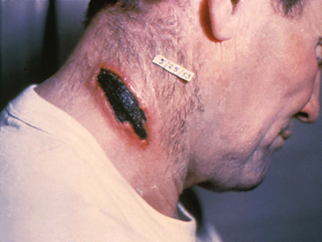
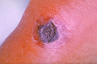
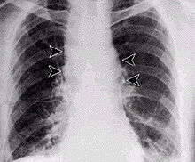
Context: Anthrax
Cutaneous
Inhalational

Slide 3
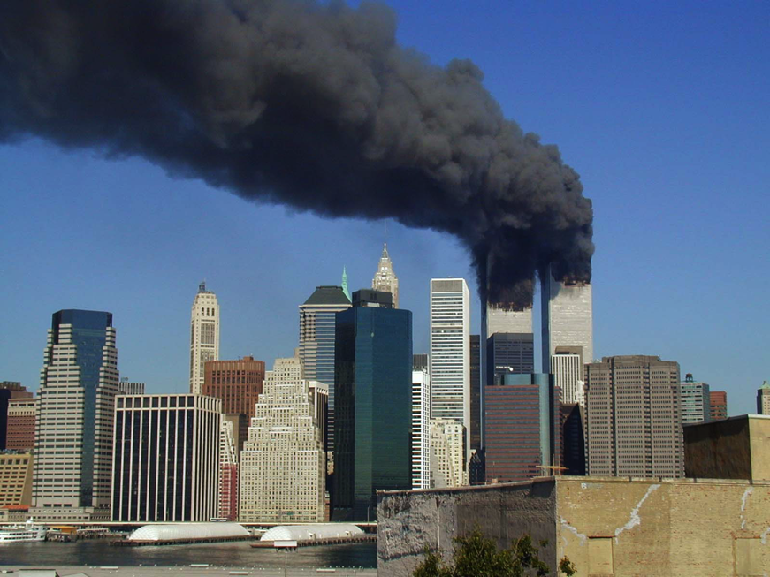
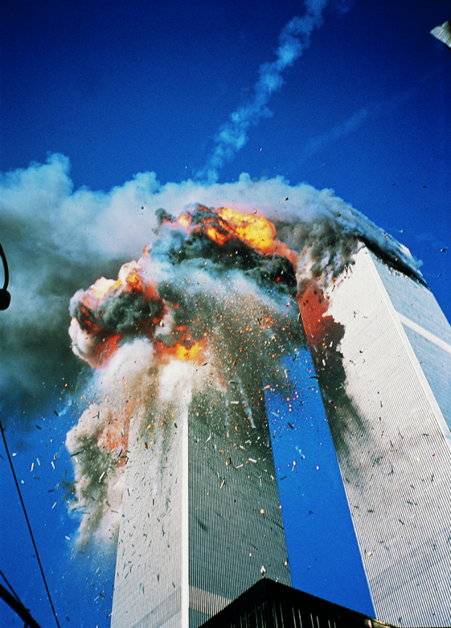
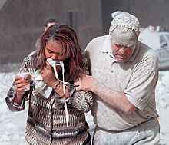
Context: September 11 2001

Slide 4
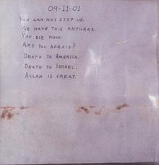
A few weeks later...

Slide 5
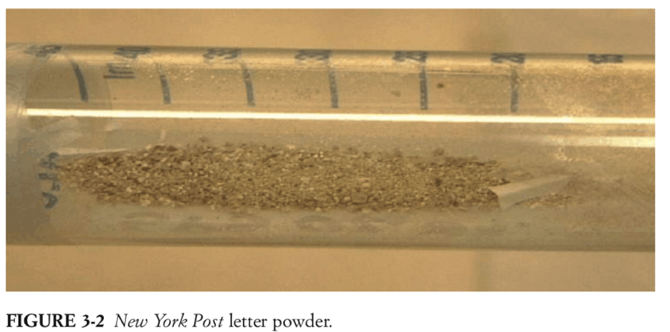
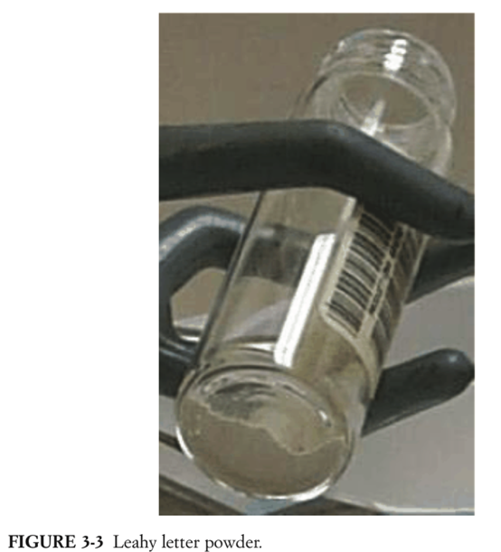
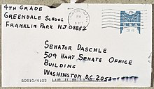
The letters
18 September:
Four letters mailed to New York City
ABC News, CBS News, NBC News, New York Post
One letter mailed to Boca Raton, Florida
National Enquirer/AMI
Contained course brown material
9 October
Two letters mailed to U.S. Senators
Tom Daschle (South Dakota)
Patrick Leahy (Vermont).
Contained fine powder

Slide 6
The victims
22 people developed anthrax
11 with inhalational anthrax
31 tested positive for exposure
10,000 took antibiotic prophylaxis
Five died of inhalational anthrax
Bob Stevens at AMI in Florida
Thomas Morris Jr. at Brentwood mail facility, Washington, D.C
Joseph Curseen at Brentwood mail facility, Washington, D.C.
Kathy Nguyen, Vietnamese immigrant resident of the Bronx
Ottilie Lundgren, 94-year-old widow of a prominent judge from Oxford, Connecticut.

Slide 7
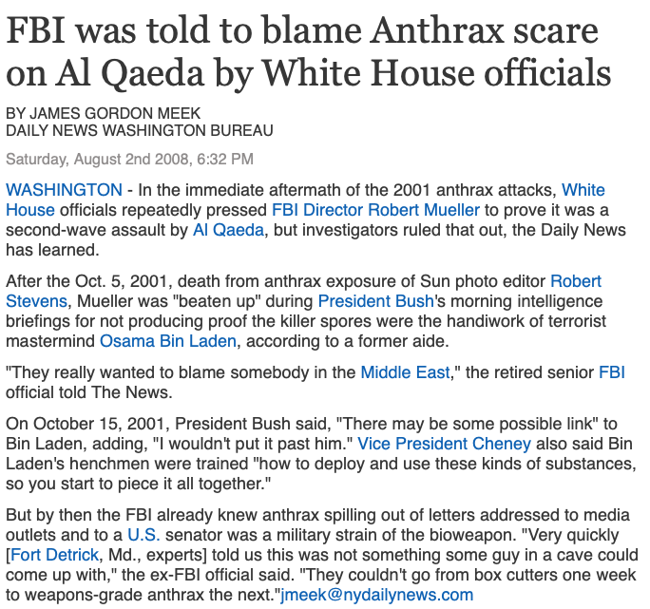
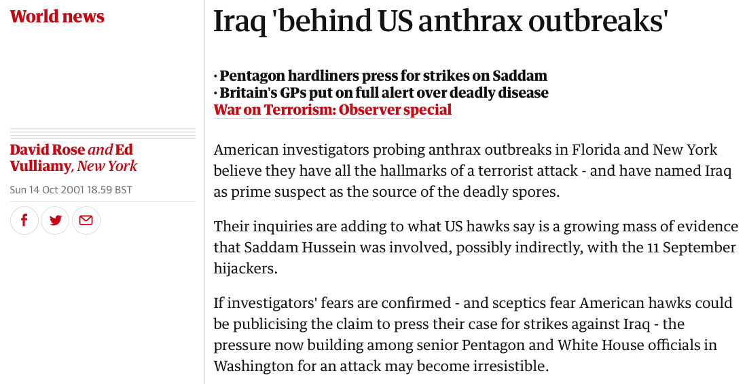
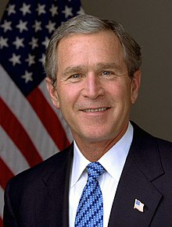
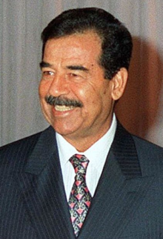

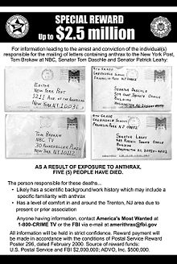

Slide 8
The FBI investigation
600,000 investigator hours
>10,000 interviews on six continents
26,000 email reviews
80 searches
6,000 items of potential evidence
5,750 grand jury subpoenas
5,730 environmental samples from 60 locations
>1000 suspects
29 labs
Scientists as witnesses helped investigate scientists as suspects

Slide 9

Strain identified...
... as the Ames strain, a commonly used lab strain, isolated from a sick cow in Texas in 1981
The culprit was likely to be a home grown microbiologist
“I tell people: I didn’t stop the Iraq war,” says Keim
“I just delayed it for two years”
Paul Keim

Slide 10
Linguistic clues?

Slide 11
Linguistic clues?
The language of the letters – specifically “Death to America, Death to Israel, Allah is Great” – obviously plays on the still very-real fears stemming from the 9/11 attacks, just a week before the first mailing.
This fact demonstrates that whoever sent the letters was trying to associate himself with al Qaeda in an effort to send the investigation far afield of a home-grown attacker.
That the perpetrator was a home-grown attacker is supported by the statement “Allah is Great.”
Experts consulted by the Task Force agreed that a true jihadi would be more likely to say “Allah Akbar” (“God is Great”).

Slide 12
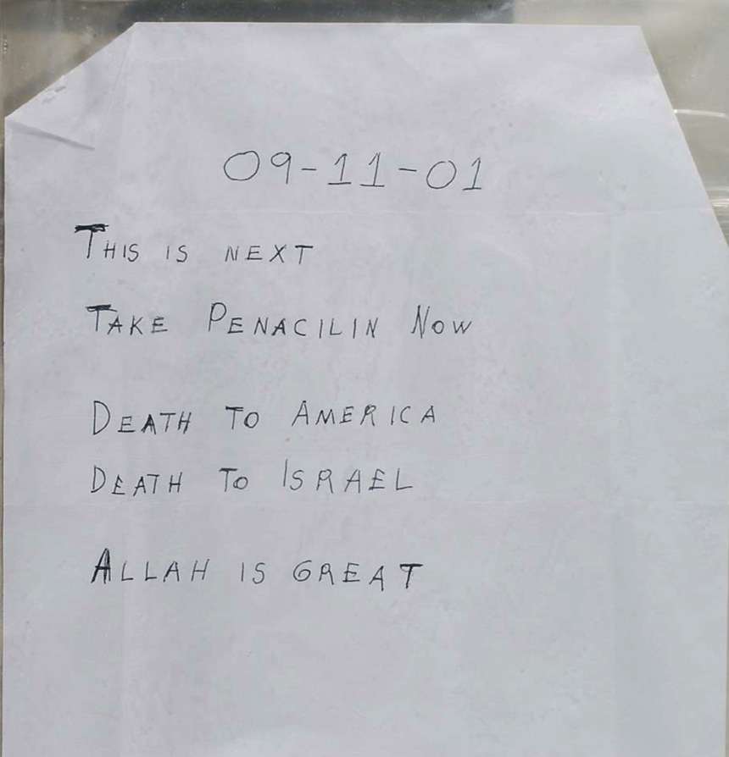
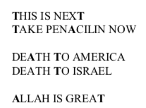
Linguistic clues?
TTT AAT TAT
F N Y
Phe Asn Tyr

Slide 13
Genetic evidence?
By late Nov 2001, variants seen in evidentiary material, based on phenotypic observation (by the naked eye), that might be explained through genetics
When a lab technician grew the spores from the letters, small percentage of colonies noticeably different in textures, colors, and growth patterns
Investigators and FBI scientists began to evaluate whether they could identify and classify these mutations genetically, thus potentially identifying source of the material used in the attacks

Slide 14

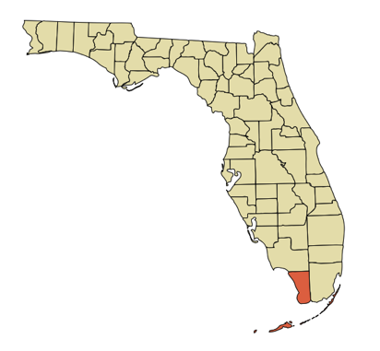
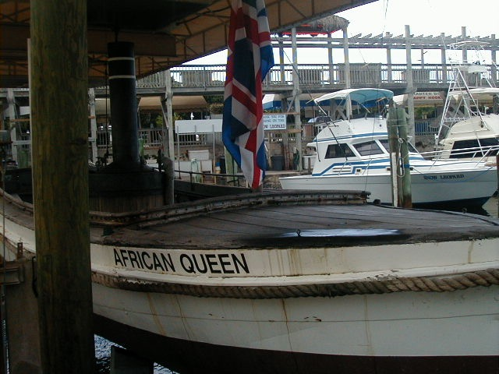
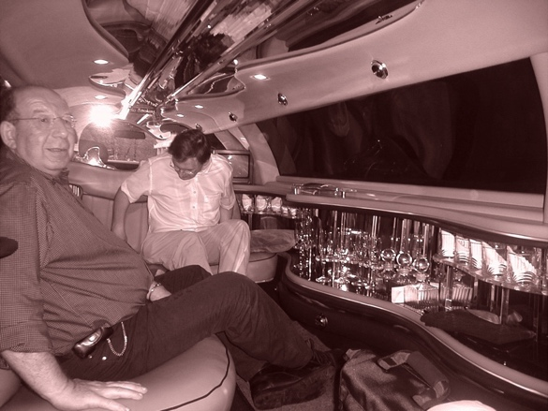

Invitation to Florida
American Academy of Microbiology colloquium held November 7-8, 2003, in Key Largo, Florida.

Slide 15

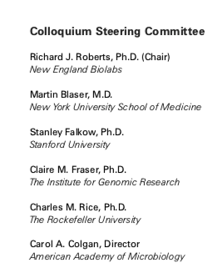
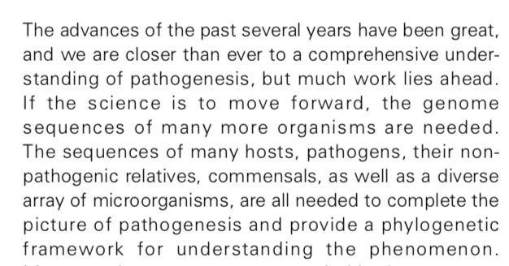


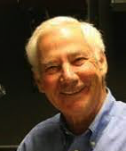

David Relman
Stan Falkow
https://www.ncbi.nlm.nih.gov/books/NBK563533/

Slide 16
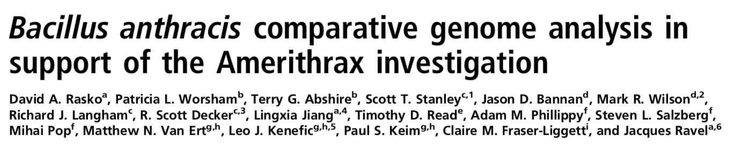
Genomic evidence
The genomes of morphological variants were sequenced and compared with that of the B. anthracis Ames ancestor.
identified four loci with verifiable genetic mutations.
¾ mutations directly linked to sporulation pathways and to the regulation of the phosphorylation state of Spo0F, linking phenotype to genotype.
None of these variant genotypes identified in single-colony environmental B. anthracis Ames isolates associated with the investigation.
identified only in B. anthracis morphotypes isolated from the letters
not prevalent in the environment, not even the environments associated with the investigation.
This study demonstrates the forensic value of systematic microbiological analysis combined with whole-genome sequencing and comparative genomics.

Slide 17
FBI Repository
FBI built database of Ames samples for comparison to the evidentiary material: FBI Repository (“FBIR”)
1,070 samples, which represents sample from every Ames culture at every lab identified by FBI as having the Ames strain!
All compared to evidentiary material using 4 genetic assays: A1 and A3, then D and E (presence/absence not quantitative)
By early 2007 eight FBIR submissions tested positive for the mutations originally found in anthrax letter evidence.
Using submission records, investigators determined that these eight samples were derived from a single source identified as RMR-1029

Slide 18
Bruce Ivins
senior microbiologist in the Bacteriology Division of USAMRIID (United States Army Medical Research Institute of Infectious Diseases), Fort Detrick, Maryland
leading US expert in the growth, sporulation, and purification of Bacillus anthracis.
began his work with Bacillus anthracis at USAMRIID in 1980.
conducted and supervised Ames anthrax spore productions for >20 years
extensive knowledge of various anthrax production protocols
adept at manipulating anthrax production and purification variables to maximize sporulation and improve the quality of anthrax spore preparations.
understood anthrax aerosolization dosage rates and the importance of purity, consistency, and spore particle size
produced large batches of Bacillus anthracis to conduct tests on vaccinated animals, during which they would inhale pre-defined doses of anthrax spores to assess the efficacy of the anthrax vaccine.

Slide 19
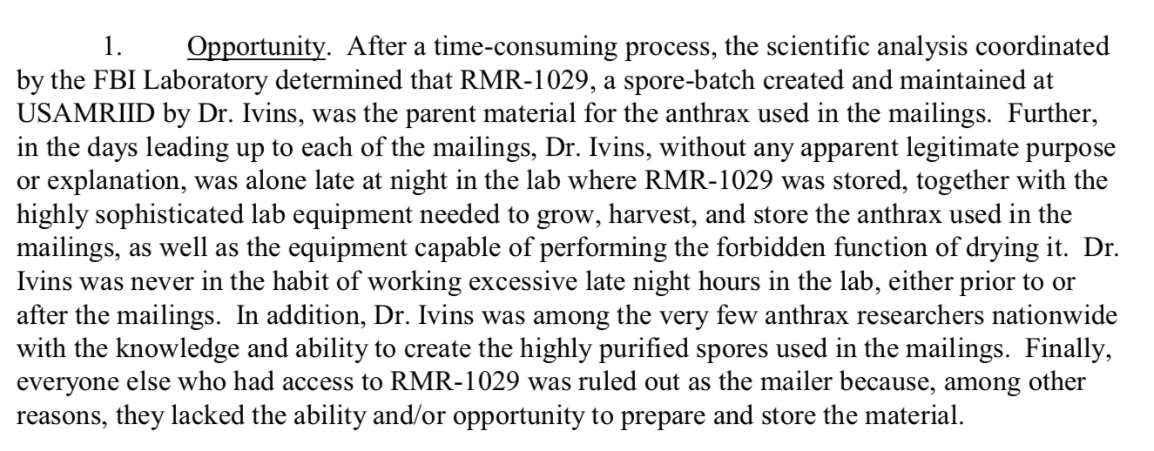

Slide 20
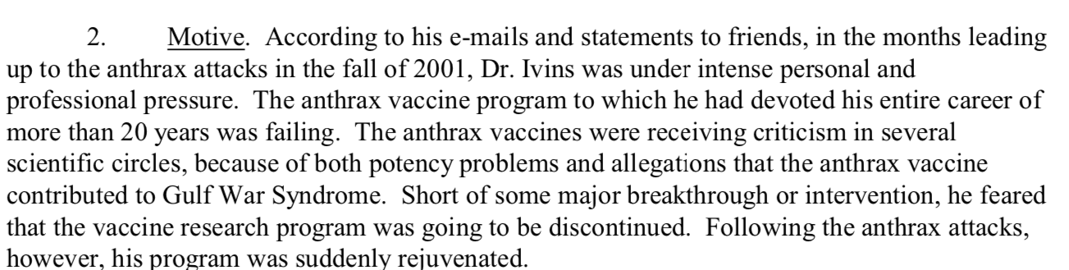
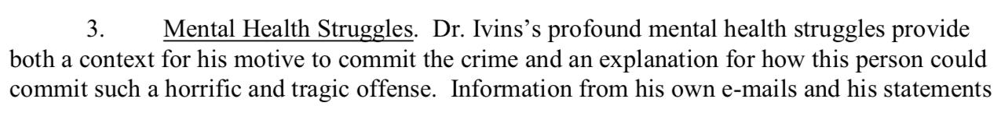
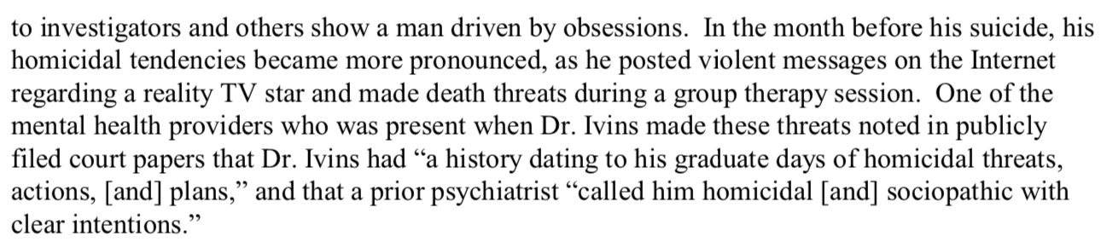

Slide 21
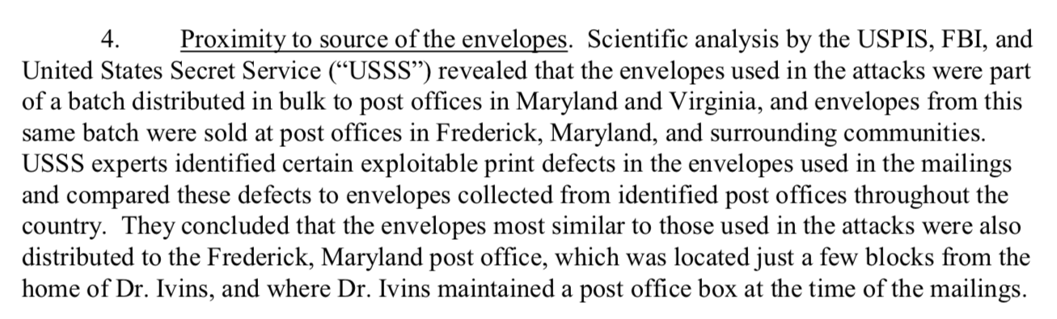

Slide 22
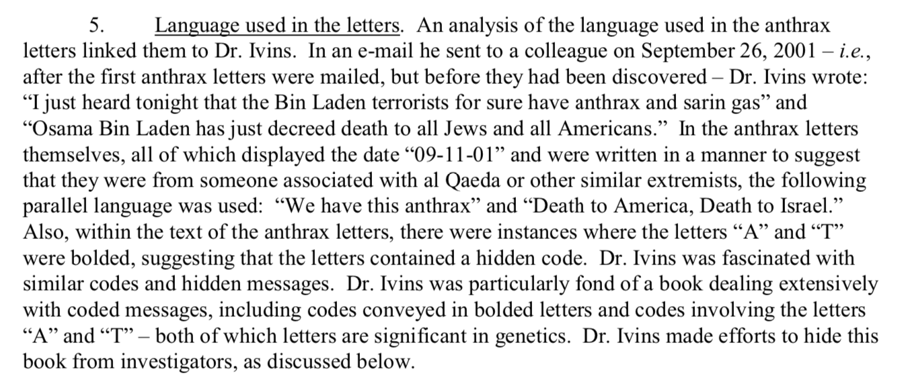

Slide 23

Gödel, Escher, Bach
difficult to summarize what book is about
basic premise: there are surface meanings (the “frame message”) and then there are meanings within mathematics (Godel), art (Escher), and music (Bach) that are hidden (the “inner message”)
numerous pages of puzzles, theorems, and other challenges to the reader, some of which someone, in what appears to be the handwriting of Dr. Ivins, actually tried to decipher on the pages of the book itself.

Slide 24

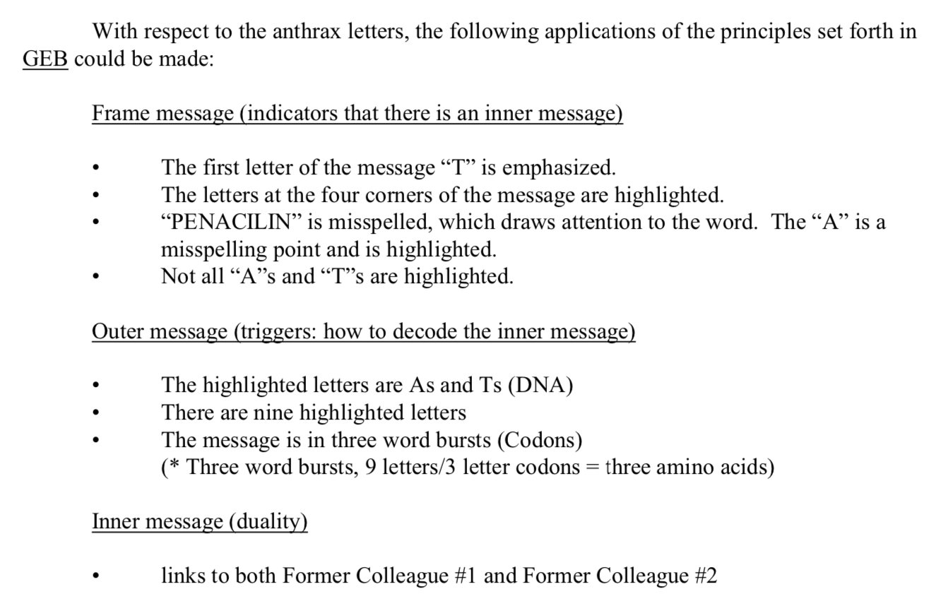
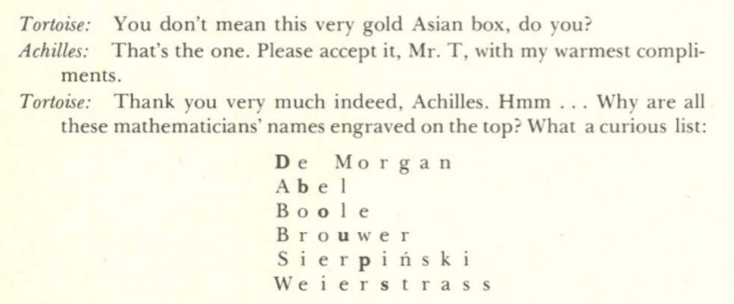
Linguistic clues?

Slide 25
Linguistic clues: FNY
code in the letters sent to Tom Brokaw and the New York Post
both in NYC
according to witnesses who knew him Ivins had a deep hatred for New York
in the aftermath of 9/11, he sent an e-mail where he essentially accused “typical” New Yorkers of overplaying the tragedy and seeking attention, wondering “what about those folks in Oklahoma City, they deserve sympathy too.”
he strongly associated a female former colleague with New York, so this reference may have been directed at her.
his communications to that colleague when she worked at USAMRIID and in the years that followed were replete with references to the New York Yankees, her favorite baseball team, not always in the kindest of terms.

Slide 26
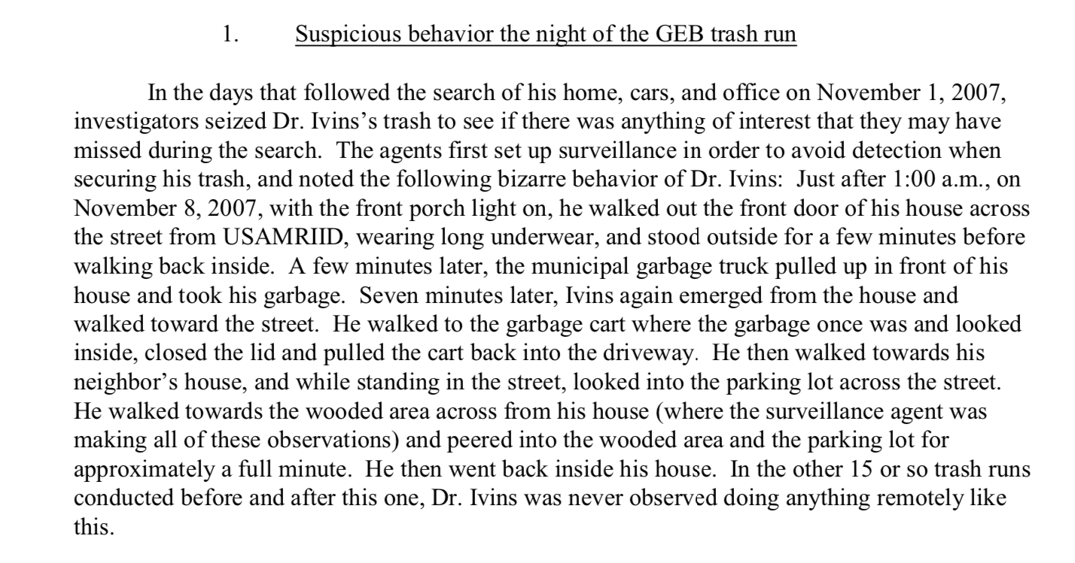
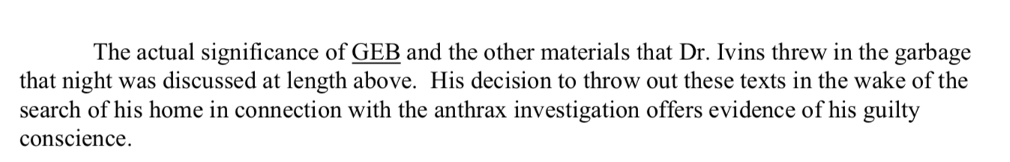

Slide 27
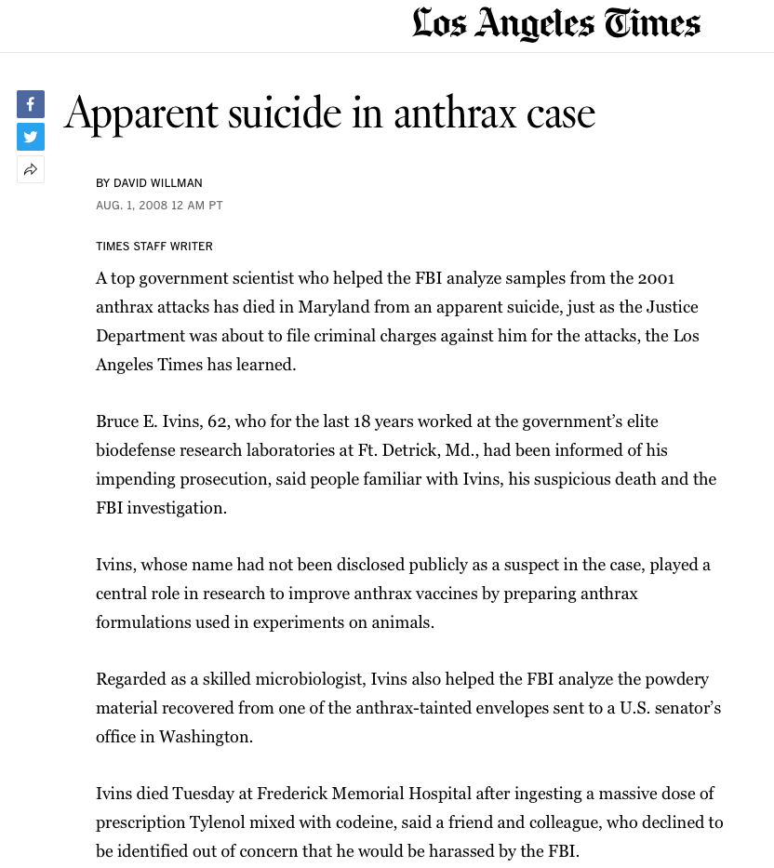
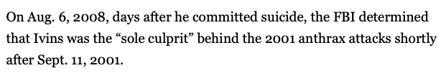
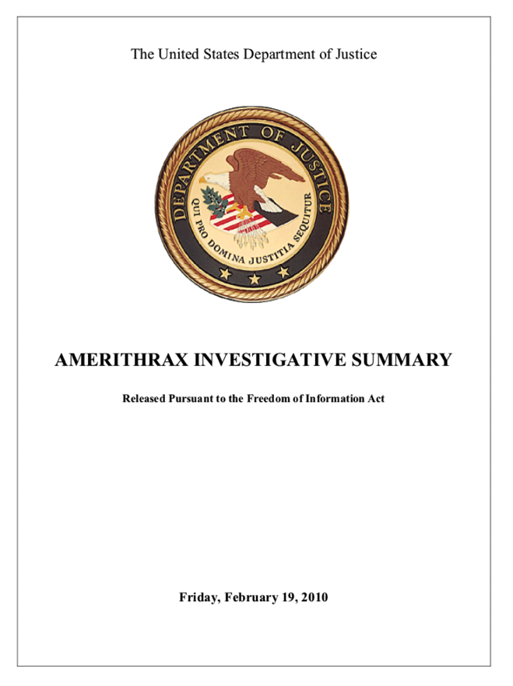
FBI closes the case on Feb 19, 2010;
releases investigative summary

Slide 28
And so??
Bruce Ivins was innocent and hounded to his death by the FB?
Bruce Ivins alone was guilty of mass murder but denied his victims their day in court?
Bruce Ivins was part of a wider conspiracy?
Not Guilty
Not Proven
Guilty
On the balance of probability
or beyond reasonable doubt?
You decide!

Slide 29
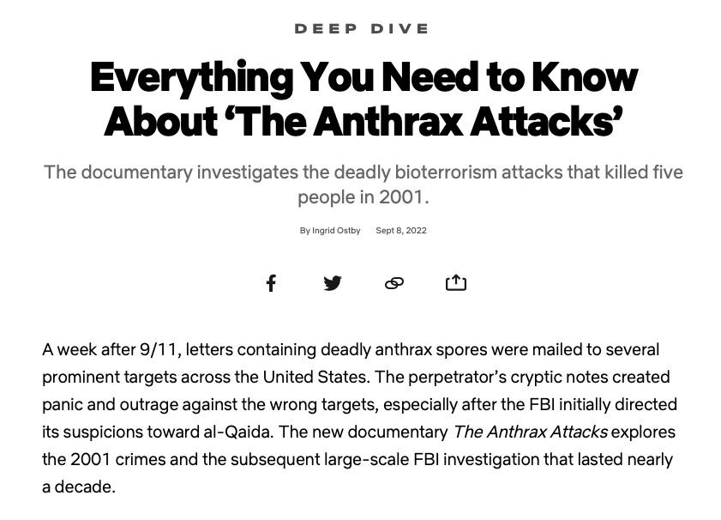
Conclusions
Amerithrax provided an interesting and innovative test case for microbial genomics in general and for forensic microbiology in particular.
We would do it differently nowadays, but precedent remains valuable
Further viewing
https://www.netflix.com/title/81213109

